Slide 1
Digital Computer Fundamentals
TOPIC: LOGIC GATES
CLASS :II B.Sc Information Technology
STAFF NAME: Ms.T.Kavitha
Assistant Professor in CS

Slide 2
LOGIC GATES
Gate A device that performs a basic operation on electrical signals
Logic gates
Logic gate is an elementary building block of a digital circuit
Most logic gates have two inputs and one output
Logic gates are the switches that turn ON or OFF depending on what the user is doing!

Slide 3
Types of Logic Gates
There are seven different types of Gates.
• AND gate
•OR gate
•NOT gate
•NAND gate
•NOR gate
•Ex-OR gate
•Ex-NOR gate

Slide 4
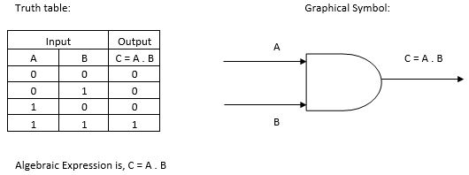
AND Gate
The AND gate is an electronic circuit that gives a high output (1) only if all its inputs are high.
A dot (.) is used to show the AND operation i.e. A.B.
Bear in mind that this dot is sometimes omitted i.e. AB

Slide 5
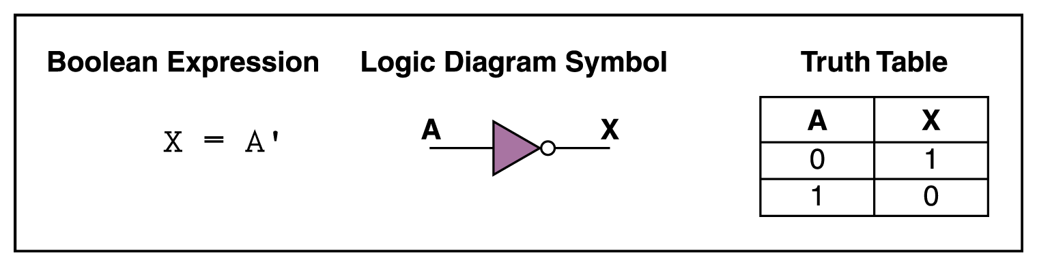
NOT Gate
The NOT gate is an electronic circuit that produces an inverted version of the input at its output.
It is also known as an inverter.
If the input variable is A, the inverted output is known as NOT A.
This is also shown as A', or A with a bar over the top.

Slide 6
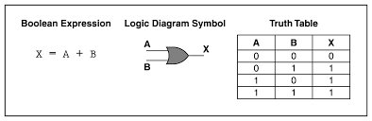
OR Gate
The OR gate is an electronic circuit that gives a high output (1)
if one or more of its inputs are high.
A plus (+) is used to show the OR operation.

Slide 7
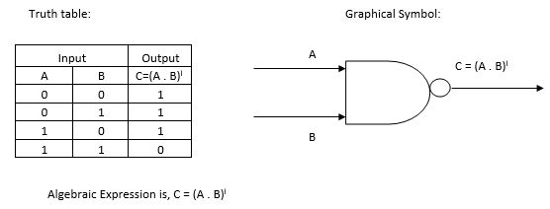
NAND gate
This is a NOT-AND gate which is equal to an AND gate followed by a NOT gate.
The outputs of all NAND gates are high if any of the inputs are low.
The symbol is an AND gate with a small circle on the output. The small circle represents inversion.

Slide 8
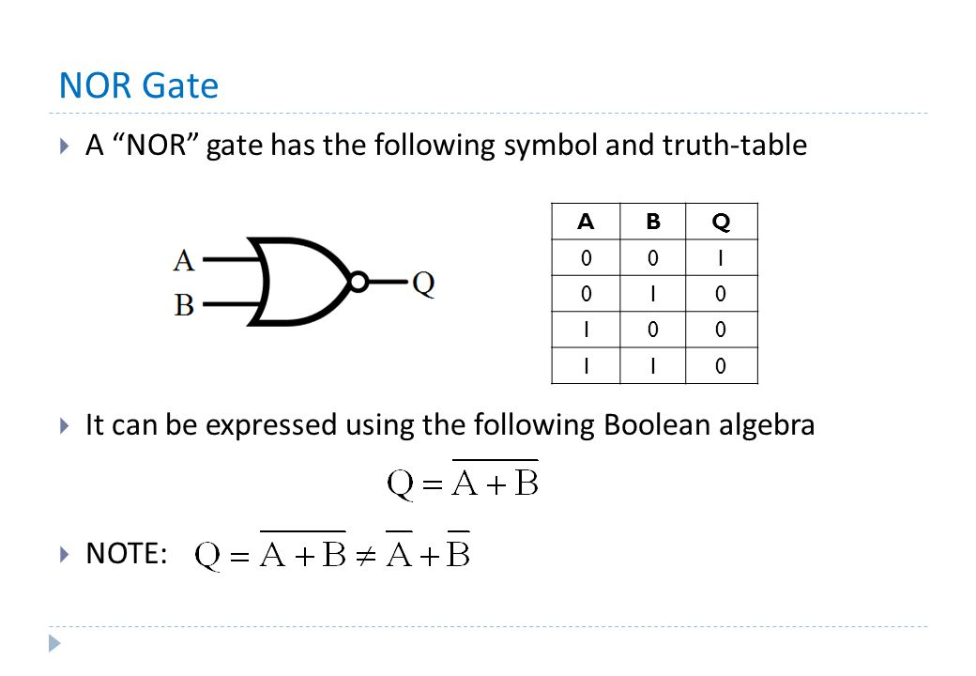
NOR gate
This is a NOT-OR gate which is equal to an OR gate followed by a NOT gate.
The outputs of all NOR gates are low if any of the inputs are high.
The symbol is an OR gate with a small circle on the output. The small circle represents inversion.

Slide 9
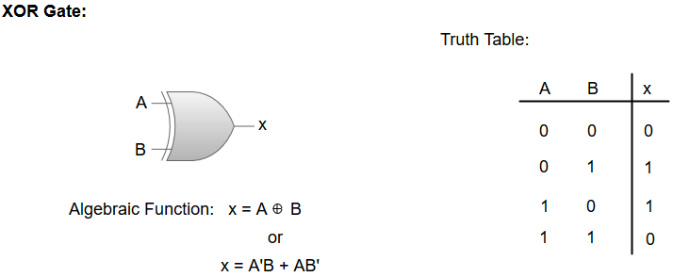
Exclusive-OR/ XOR GATE:
The 'Exclusive-OR' gate is a circuit which will give a high output if one of its inputs is high but not both of them.
The XOR operation is represented by an encircled plus sign.

Slide 10
EXCLUSIVE-NOR/Equivalence GATE:
It will give a low output if one of its inputs is high but not both of them.
The 'Exclusive-NOR' gate is a circuit that does the inverse operation to the XOR gate.
The small circle represents inversion

Slide 11
EX-OR gateThe 'Exclusive-OR' gate is a circuit which will give a high output if either, but not both, of its two inputs are high.
An encircled plus sign ( ) is used to show the EOR operation.

